Slide 1
Pre study: Next Generation RDM/EFACTS/TEST MANAGER
160602
Magnus Söder

Slide 2
Background In short - Prestudy
Our succesful solutions RDM, EFACTS & PVT Manager to support the Functional Test (winner Volvo Group internal quality award 2014) within FVV have reached its end of lifecycle.
They need to be rebuilt & redefined to meet new & future challenges for Functional test as well as supporting a wider usage for other areas like AET/RT.
The plan is to initiate a pre-study to define how a future set-up should look like and how to get there.
NOTE: Already Initiated EN on existing RDM/EFACTS should not exceed/interfere with Next Gen Solution functionality!
Functionality level
Prestudy
Development
Launch
Next Gen RDM/Efacts
Existing RDM/Efacts
Scope of this request
Minor EN
Time

Slide 3
As-Is Package Simplified
Tool to support Tester with Test Codes, Activities & Reports
Web interface for remote retrieval of test & measurement data from test vehicles around the world and configuration of on-board data loggers
RDM
PVT Manager
EFACTS
EFACTSRefiner
Database and tool to take care of incoming field test data for functional testing often software based services
Solution to be able to refine/review retrieved test & measurement data

Slide 4

Principal approach
As-Is Situation
Future structure & solutions (Pre Study to define)
RDM
PVT Manager
EFACTS
Refiner
Pre Study
Test Manager
Remote Communication
Data Distribution
Functional Testing
Data Refiner
Test Tablet HW
Request today

Slide 5
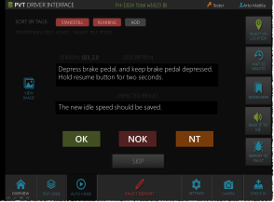



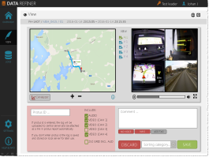

Project Content Conceptual target
Tool to support Tester with Dynamic Test Codes and intuitive Report Templates
Communication platform for Remote retrieval and storage of test and measurement data from test vehicles around the world including configuration of data loggers
Test Manager
Remote retrieval and storage of test and measurement data from test vehicles around the world
Tool to take care of incoming field test data for functional testing often software based services
Remote Communication
Data Distribution
Functional Testing
Data Refiner
Test Tablet HW
Hardware solution (Tablet + App) for Tester of Vehicle based on Test Manager
Improved solution to be able to refine/review retrieved test data for increased quality

Slide 6
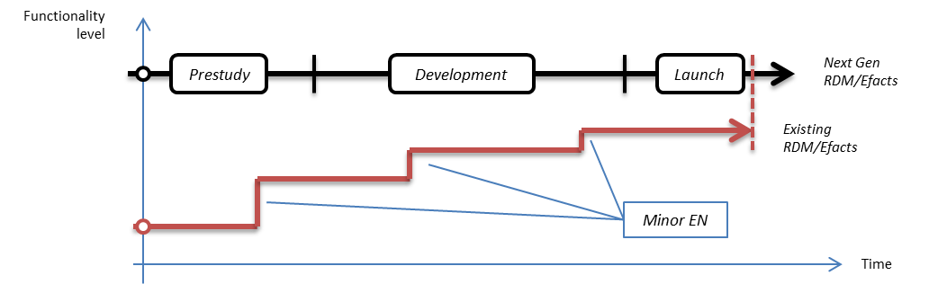
Request Scope
Request for 2 initial resources (from Group IT) for Aug → Dec
1 Pre Study Leader (approx 80% FTE) becoming CPM later on
1 Information Architect (approx FTE TBD)
Additional resources - TBD
Requested for relase by L3 V&V:
600 kSEK
Budget available 2016 (Combined for all TCP* initiatives):
1 200 kSEK
Initiate Pre-study Activity
Pre-study Deliverables
Define business requirements & related scope
Define relevant Information Architecture to support scope
Propose project set-up (one or many) including deliverables
Define related business case for this initiative
^{*)}TCP – Test Collaboration Platform

Slide 7
Appendix

Slide 8

TCP Concept Test Collaboration Platform

Slide 9
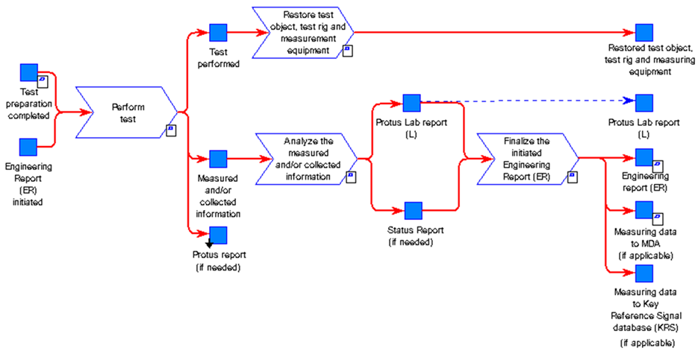
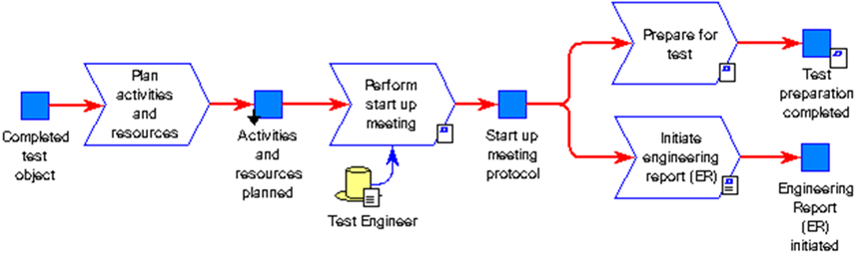
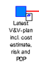
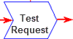
TO-BE
GTDM & TCP – Conceptual map
Test Collaboration Platform
GTDM Scope
Up- date
Re-plan
BOSS
GHOST
Test Manager
Incl Test Module?
HPG Planning tool
AXXOS
V&V plan
Defines acceptance criteria and methods. Selecting test objects and create time plan.
Test request
Based on V&V plan the test should be initiated e.g. n-8 weeks before the actual test should start.
In order to secure parts, material, resources and test object build. Quotation secured.
Plan activities and resources All needed resources and budget is secured.
Prepare for test The test object is
e.g. prepared with measurement equipment. The test procedure and method is prepared and secured.
Analyze/Reporting
Perform test Measurement systems and tools are efficient and control and give support during the test execution. E.g. test procedure, KPI, progress and status is available (results/running/faults found).
PROTUS
Vehicle Logging Tool
Data handling
Results and data are analyzed, documented and published. The data is also made available to upload for analysis or as input for future testing.
GHOST incl Test Module ?
Data information exchange
”Test Collaboration Platform”

Slide 10
PVT Step 2 Required updates to support evolving PVT needs Jessica Erlandsson, Tim Jansson & Arto Mattila
Presentation material:

Slide 11
Test Manager Tool Why we need an updated solution Martin Svennungsson
Presentation material:

